Slide 1
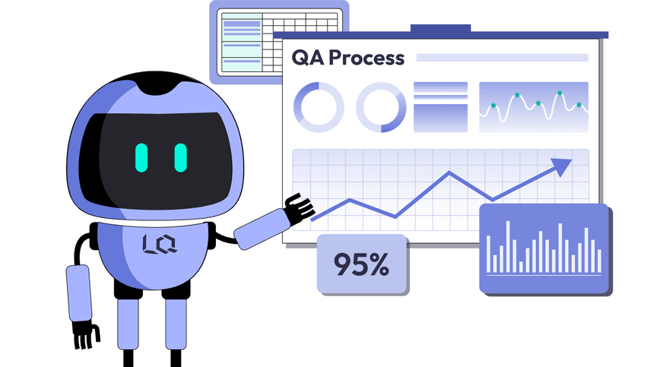
Software Quality Assurance Processes and Activities
Kevin McMahon
QA Team Lead

Slide 2

Software Quality Assurance (SQA)
Definition and purpose
Quality across the SDLC
Standards and compliance mindset
From best practices to process
Notes:
Software Quality Assurance, or SQA, is the structured process used to make sure all activities within the Software Development Life Cycle follow defined quality standards. Rather than focusing only on testing at the end of development, SQA emphasizes maintaining quality from the earliest stages, including requirements gathering, design, implementation, and deployment. The purpose of SQA is to apply proven best practices in a consistent and repeatable way so teams are not relying on informal or ad hoc methods. By turning general testing guidelines into documented processes, SQA helps organizations improve reliability, accountability, and overall product quality throughout the entire project lifecycle.

Slide 3
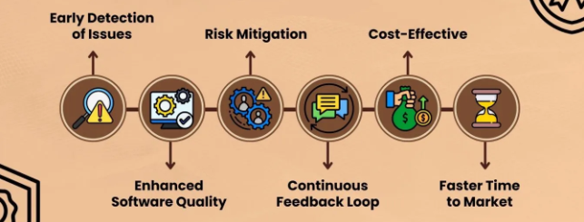
Intent of SQA
Maintain quality end-to-end
Define how work is done
Make outputs reviewable/testable
Support auditing and improvement
Notes:
The main intent of Software Quality Assurance is to maintain quality across the entire Software Development Life Cycle, not just during the testing phase. SQA defines how work should be performed by establishing clear processes for activities such as requirements reviews, design validation, code reviews, and test planning. This helps teams move away from informal practices and instead follow consistent, repeatable methods that improve reliability and accountability throughout the project.
Another important goal of SQA is to make project outputs reviewable and testable at every stage. By enforcing structured documentation, review checkpoints, and standardized procedures, SQA allows teams to identify issues early and reduce overall project risk. In addition, SQA supports auditing and continuous improvement by allowing organizations to evaluate what worked well and what needs refinement. This ongoing feedback loop helps improve future projects and strengthens overall software quality over time.

Slide 4
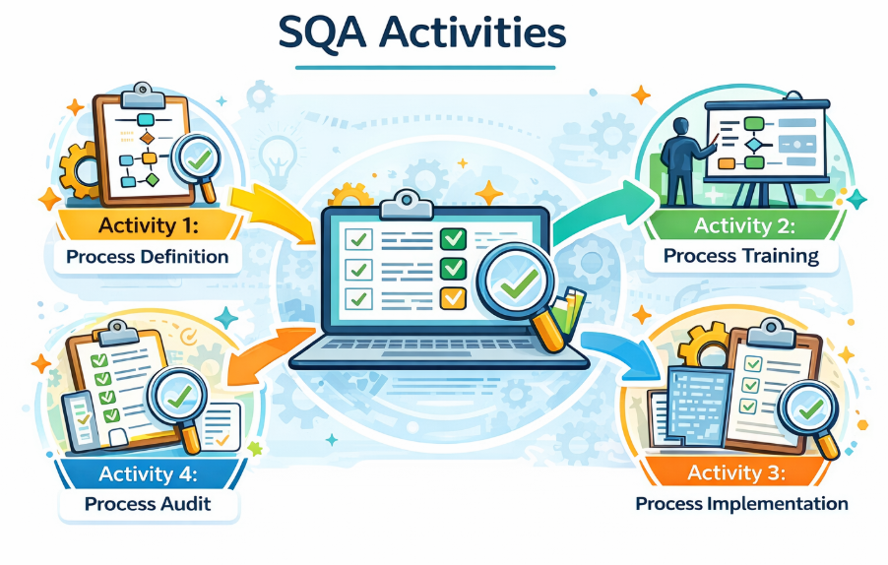
SQA Activities Overview
Process definition
Process training
Process implementation
Process audit
Notes:
This slide summarizes the four core activities that make up the Software Quality Assurance process: process definition, training, implementation, and auditing. Together, these activities create a structured quality framework that is applied throughout the Software Development Life Cycle.
The first step is process definition, where the team establishes project-specific quality standards, review procedures, and documentation formats. Once the process is defined, training is performed so all team members understand expectations and follow the same quality approach. This helps reduce inconsistencies and miscommunication across development roles.
Next, the implementation phase applies these defined standards during actual development activities such as requirements reviews, code reviews, and test execution. Finally, the audit phase evaluates whether the process was followed correctly and identifies gaps or improvement opportunities. This feedback loop allows teams to refine their SQA practices over time and continuously improve software quality across future project cycles.

Slide 5
Activity 1: Process Definition
Examples: Standard test case template,
Code review Checklists
Project-specific quality process
Reviews for requirements/design
Code review expectations
Standard formats for test work
Notes:
Process definition is the foundation of the entire SQA framework because it establishes how quality will be managed for a specific project. Instead of relying on general best practices alone, the team defines project-specific quality processes that match the scope, risk level, and complexity of the system being developed. This includes deciding how requirements and design reviews will be conducted and what approval steps are required before moving to the next SDLC phase.
Another important part of this activity is setting clear expectations for code reviews. Teams define what standards developers must follow, such as coding conventions, documentation requirements, and defect severity classifications. This makes reviews more consistent and prevents subjective or uneven quality evaluations.
Lastly, standardized formats for test plans, defect reports, and review documentation are created. Having consistent templates improves traceability, simplifies audits later in the project, and allows stakeholders to easily verify that quality activities are being performed correctly and consistently across the development lifecycle.

Slide 6
Activity 2: Process Training
Examples: QA Onboarding training session, Team
Workshop on testing standards.
Train team on the process
Align vocabulary and expectations
Reduce inconsistent execution
Support adoption across roles
Notes:
Once the SQA processes have been defined, the next critical step is training the project team on how those processes will be used. This training makes sure that developers, testers, analysts, and managers all understand the quality procedures, review expectations, and documentation standards that were established during process definition. Without proper training, even well-designed quality processes will fail because team members may apply them incorrectly or inconsistently.
Another key goal of process training is aligning vocabulary and expectations across roles. When everyone uses the same terminology for defects, reviews, test plans, and approval checkpoints, communication becomes clearer and misunderstandings are reduced. This helps prevent errors that occur when different teams interpret quality requirements differently.
Process training also supports consistent execution across the SDLC. By teaching teams how and when to apply reviews, audits, and testing activities, organizations reduce variation in how work is performed. This improves reliability, strengthens accountability, and helps the entire project team adopt the SQA framework as a shared responsibility rather than viewing it as a separate QA only task.

Slide 7
Activity 3: Process Implementation
Examples: Running code reviews during sprint,
Executing test plan during development
Use the process during SDLC
Perform reviews as planned
Apply agreed standards
Document outcomes and findings
Notes:
Process implementation is where the defined SQA procedures are actively used during the Software Development Life Cycle. At this stage, teams apply the quality processes that were previously documented and trained, such as performing requirements reviews, design inspections, code reviews, and structured testing activities. This step is important because it moves SQA from planning into real execution.
Another key aspect of implementation is performing reviews as scheduled. These reviews act as quality checkpoints that verify deliverables meet project standards before moving to the next phase of development. By identifying issues early, teams reduce the risk of defects reaching later stages where fixes become more costly and time consuming.
Applying agreed on standards also promotes consistency across the project. When coding standards, documentation templates, and testing procedures are followed, outputs become easier to verify and audit. To finish, documenting outcomes and findings creates a record of decisions, defects, and improvements. This documentation supports accountability, traceability, and continuous process improvement for future development cycles.

Slide 8
Activity 4: Process Audit
Examples: Post release quality audit report,
Process compliance checklist review.
Verify process was followed
Identify gaps and friction points
Capture lessons learned
Refine process for next cycle
Notes:
The process audit phase focuses on verifying that the SQA procedures were actually followed during the project. This involves reviewing documentation, checking completed reviews, and confirming that testing and quality activities were performed according to the defined process. Audits help organizations move beyond assumptions and rely on evidence to validate quality practices.
Another important goal of auditing is identifying gaps and friction points in the workflow. These are areas where the process may be inefficient, unclear, or difficult for team members to follow. By locating these weaknesses, teams can address root causes instead of repeatedly fixing surface level issues.
Capturing lessons learned is also a critical outcome of the audit phase. These insights help teams understand what worked well and what needs improvement. To end with, the audit results are used to refine the SQA process for the next development cycle, supporting continuous improvement and better long term software quality.

Slide 9

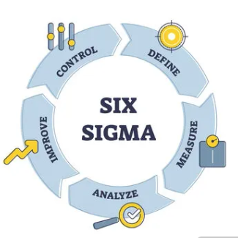
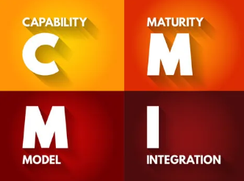
Software Quality Management Models
Frameworks to guide SQA
CMMI maturity levels
ISO 9000 general standard
Six Sigma process improvement
Notes:
Software Quality Management Models provide structured frameworks that help organizations apply SQA practices in a consistent and organized way. Instead of relying on informal methods, these models define standards, processes, and improvement strategies that guide how quality activities are planned and executed across projects.
One common model is CMMI, or Capability Maturity Model Integration. CMMI uses five maturity levels that range from initial and unmanaged processes to fully optimized and continuously improving workflows. Organizations gradually progress through these levels by formalizing processes, measuring performance, and improving quality controls over time.
Another widely used standard is ISO 9000, which focuses on quality management system requirements. Unlike CMMI, ISO 9000 is more general and applies across many industries. It emphasizes standardized procedures, documentation, and repeatable processes that help organizations maintain consistent quality output.
Six Sigma is a process improvement model that targets defect reduction by using data and statistical analysis. It focuses on identifying root causes of errors and improving business processes to prevent quality issues before they occur. Together, these models support structured, measurable, and scalable quality management practices.

Slide 10

Advantages, Disadvantages, and When It Makes Sense
Improves quality and consistency
Reduces long term cost
Overhead and culture shift risk
Best for large or high risk systems
Notes:
One of the main advantages of implementing SQA processes and quality management models is improved software quality and consistency. When teams follow defined processes, standards, and review procedures, defects are identified earlier and deliverables become more reliable. This also improves customer satisfaction because users experience fewer errors and more stable releases.
Another important benefit is long term cost reduction. While SQA may require upfront investment, preventing defects early in the SDLC reduces expensive rework, post release fixes, and support costs. Higher quality products also reduce downtime and maintenance efforts over time.
However, there are disadvantages to consider. SQA can introduce additional overhead, including documentation requirements, training time, and the need for specialized roles or consultants. Organizations may also experience a culture shift, especially when teams are not used to structured processes and audits. This adjustment period can temporarily slow productivity.
SQA models make the most sense for large, complex, or high risk systems. Projects involving safety critical software, medical systems, financial platforms, or large enterprise applications benefit the most from formal quality management practices because reliability and accuracy are essential.

